Slide 1
ECE 530 Cloud Computing
Ioannis Papapanagiotou
CAP Theorem

Slide 2
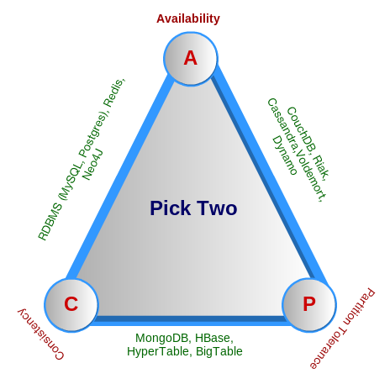
Eric Brewer’s CAP theorem
In a famous 2000 keynote talk at ACM PODC, Eric Brewer proposed that “you can have just two” from
Consistency (all nodes see the same data at the same time)
Availability (a guarantee that every request receives a response about whether it was successful or failed)
Partition tolerance (the system continues to operate despite arbitrary message loss or failure of part of the system)

Slide 3
Interactions with Web services
operations commit or fail in their entirety (atomic)
committed transactions are visible to all future transactions (consistent)
un-committed transactions are isolated from each other (isolated)
once a transaction is committed it is permanent (durable)
Notes:
It is clearly important that billing information and commercial transaction records be handled with this type of strong consistency.

Slide 4
Consistency: Atomic Data Objects
The most natural way of formalizing the idea of consistent service is as an atomic data object
Definition: There must exist a total order on all operations such that each operation looks as if it were complete at a single instant
This is equivalent to requiring requests if the distributed shared memory to act as if they were executing in a single node, responding to operations one at a time.
Atomic read/write shared memory
Any read operation that begins after a write operation completes must return that value, or the result of a later write operation.

Slide 5
Consistency: What does it mean?
As used in CAP, consistency is about two things
First, that updates to the same data item are applied in some agreed-upon order
Second, that once an update is acknowledged to an external user, it won’t be forgotten
Not all systems need both properties

Slide 6

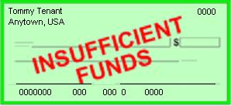
Consistency: But inconsistency brings risks too!
My rent check bounced?
That can’t be right!
Inconsistency causes bugs
Clients would never be able to trust servers… a free-for-all
Weak or “best effort” consistency?
Strong security guarantees demand consistency
Would you trust a medical electronic-health records system or a bank that used “weak consistency” for better scalability?
Jason Fane Properties 1150.00
Sept 2009 Tommy Tenant

Slide 7
From ACID to BASE
Database developers all know the ACID acronym. It says that database transactions should be:
Atomic: Everything in a transaction succeeds or the entire transaction is rolled back.
Consistent: A transaction cannot leave the database in an inconsistent state.
Isolated: Transactions cannot interfere with each other.
Durable: Completed transactions persist, even when servers restart etc.
These qualities seem indispensable, and yet they are incompatible with availability and performance in very large systems.

